Slide 1
Control Flow Statements
Kaustubh Kulkarni

Slide 2
Introduction
The statements inside your source files are generally executed from top to bottom, in the order that they appear.
Control flow statements, however, break up the flow of execution by employing decision making, looping, and branching, enabling your program to conditionally execute particular blocks of code.
In this lesson we will study
the decision-making statements (if-then, if-then-else, switch)
the looping statements (for, while, do-while)
the branching statements (break, continue, return)

Slide 3
The if-then Statement
It tells your program to execute a certain section of code only if a particular test evaluates to true.
For example, the Bicycle class could allow the brakes to decrease the bicycle's speed only if the bicycle is already in motion.
If this test evaluates to false (meaning that the bicycle is not in motion), control jumps to the end of the if-then statement.
void applyBrakes() {
// the "if" clause: bicycle must be moving
if (isMoving){
// the "then" clause: decrease current speed
currentSpeed--;
}
}

Slide 4
The opening and closing braces are optional, provided that the "then" clause contains only one statement:
void applyBrakes() {
// same as above, but without braces
if (isMoving)
currentSpeed--;
}

Slide 5
Deciding when to omit the braces is a matter of personal taste.
Omitting them can make the code more brittle.
If a second statement is later added to the "then" clause, a common mistake would be forgetting to add the newly required braces.
The compiler cannot catch this sort of error; you'll just get the wrong results.

Slide 6
The if-then-else Statement
The if-then-else statement provides a secondary path of execution when an "if" clause evaluates to false.
You could use an if-then-else statement in the applyBrakes method to take some action if the brakes are applied when the bicycle is not in motion.
In this case, the action is to simply print an error message stating that the bicycle has already stopped.

Slide 7
void applyBrakes() {
if (isMoving) {
currentSpeed--;
} else {
System.err.println("The bicycle has already stopped!");
}
}

Slide 8
Refer IfElseDemo.java

Slide 9
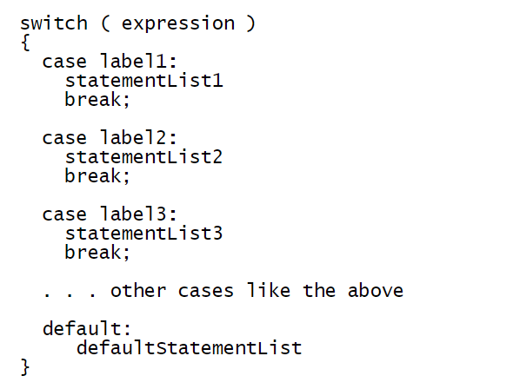
The switch Statement
Unlike if-then and if-then-else statements, the switch statement can have a number of possible execution paths.

Slide 10
A switch works with the byte, short, char, and int primitive data types.
It also works with strings or enum variables
Refer:
SwitchDemo.java
SwitchDemo2.java
StringSwitchDemo.java

Slide 11
Enum Types
An enum type is a special data type that enables for a variable to be a set of predefined constants.
The variable must be equal to one of the values that have been predefined for it.
Common examples include compass directions (values of NORTH, SOUTH, EAST, and WEST) and the days of the week.
Because they are constants, the names of an enum type's fields are in uppercase letters.
You define an enum type by using the enum keyword.
You should use enum types any time you need to represent a fixed set of constants.
That includes natural enum types such as data sets where you know all possible values at compile time for example, the choices on a menu, command line flags, and so on.

Slide 12
The while Statement
The while statement continually executes a block of statements while a particular condition is true. Its syntax can be expressed as:
while (expression) {
statement(s)
}
The while statement evaluates expression, which must return a boolean value.
If the expression evaluates to true, the while statement executes the statement(s) in the while block.
The while statement continues testing the expression and executing its block until the expression evaluates to false.

Slide 13
The do-while Statement
The Java programming language also provides a do-while statement.
The difference between do-while and while is that do-while evaluates its expression at the bottom of the loop instead of the top.
Therefore, the statements within the do block are always executed at least once
Syntax:
do {
statement(s)
} while (expression);

Slide 14
You can implement an infinite loop using the while / do-while statement as follows:
while (true)

Slide 15
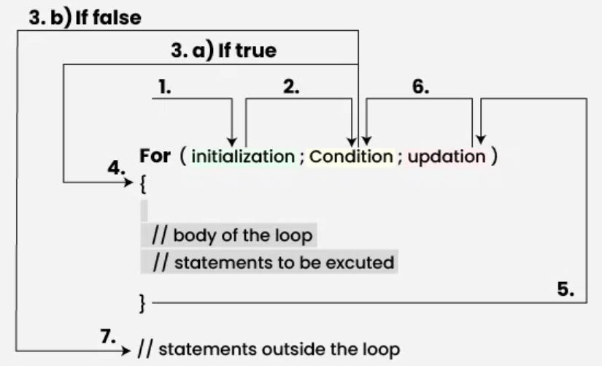
The for Statement

Slide 16
class ForDemo {
public static void main(String[] args){
for(int i=1; i<11; i++){
System.out.println("Count is: " + i);
}
}
}

Slide 17
Notice how the code declares a variable within the initialization expression.
The scope of this variable extends from its declaration to the end of the block governed by the for statement, so it can be used in the termination and increment expressions as well.
If the variable that controls a for statement is not needed outside of the loop, it's best to declare the variable in the initialization expression.
The names i, j, and k are often used to control for loops; declaring them within the initialization expression limits their life span and reduces errors.

Slide 18
Infinite loop using for
The three expressions of the for loop are optional; an infinite loop can be created as follows:
for ( ; ; ) {
// your code goes here
}

Slide 19
double[] ar = {1.2, 3.0, 0.8};
int sum = 0;
for (int i = 0; i < ar.length; i++) {
// i indexes each element successively.
sum += ar[i];
}

Slide 20
For-Each / Enhanced For loop
double[] ar = {1.2, 3.0, 0.8};
int sum = 0;
for (double d : ar) {
// d gets successively each value in ar.
sum += d;
}

Slide 21
Where the for-each is appropriate
Only access. Elements can not be assigned to, eg, not to increment each element in a collection.
Only single structure. It's not possible to traverse two structures at once, eg, to compare two arrays.
Only single element. Use only for single element access, eg, not to compare successive elements.
Only forward. It's possible to iterate only forward by single steps.

Slide 22
break and continue
The only way to exit a loop, in the usual circumstances is for the loop condition to evaluate to false.
There are however, two control flow statements that allow you to change the control flow.
break causes the control flow to exit current loop body (as if the loop condition has just evaluated to false)
continue causes the control flow to jump to the loop condition (for while, do while loops) or to the update (for for loops). This causes control flow to jump to the next iteration.

Slide 23
Examples
Refer PrimeCheck.java
Refer ShoppingCart.java

